Slide 1
CHAPTER-8 Advanced Technologies in Multimedia

Slide 2
8.1 Multimedia Operating System (MMOS)
8.1.1 Introduction
MMOS is the system software that handles multimedia data and multimedia devices.
The operating system is the shield of the computer hardware against all software components.
It provides a comfortable environment for the execution of programs, and it ensures effective utilization of the computer hardware.
The operating system offers various services, related to the essential resources of a computer: CPU, main memory, storage and all input and output devices.
The integration of discrete and continuous multimedia data demands additional services from many operating system components.
The major aspect in this context is real-time processing of continuous media data.

Slide 3

Real Time Systems
Real time process is the process which delivers the result of processing in a given time-span.
The main characteristic of real-time systems is the correctness of the computation.
Errorless computation
The time in which the result is presented
Speed and efficiency are not the main characteristic of real-time systems. (e.g. the video data should be presented at the right time, neither too quickly nor too slowly)
Timing and logical dependencies among different related tasks, processed at the same time, must also be considered.

Slide 4
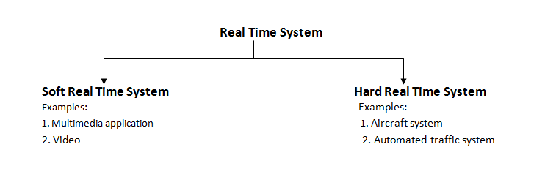
Deadlines:
A deadline represents the latest acceptable time for the presentation of a processing result.
It marks the border between normal (correct) and anomalous (failing) behavior.

Slide 5
A real-time system has both hard and soft deadlines.
Soft deadline:
A deadline which cannot be exactly determined and which failing to meet does not produce an unacceptable result.
Example of soft real time system is: Multimedia system and Video stream
Its miss may be tolerated as long as
(1) not too many deadlines are missed and/or
(2) the deadlines are not missed by much.
Hard deadline:
A deadline which should never be violated.
Its violation causes a system failure.
Determined by the physical characteristics of real-time processes.
Example of hard real time system is: railway signaling, flight control

Slide 6
RTS
RTS is the system, which operate its operation in consideration with time.
Characteristics of Real Time Systems
The necessity of deterministic and predictable behavior of real-time systems requires processing guarantees for time-critical tasks.
Such guarantees cannot be assured for events that occur at random intervals with unknown arrival times, processing requirements or deadlines.
Predictably fast response to time-critical events and accurate timing information.
A high degree of schedulability: to meet the deadlines.
Stability under transient overload: critical task first.

Slide 7
Real time and multimedia
The real-time requirements of traditional real-time scheduling techniques usually have a high demand for security and fault-tolerance. (Most of them involve system control.)
Real-time requirements of multimedia systems:
The fault-tolerance requirements of multimedia systems are usually less strict than those of real-time systems that have a direct physical impact.
For many multimedia system applications, missing a deadline is not a severe failure, although it should be avoided. (e.g. playing a video sequence)
In general, all time-critical operations are periodic and schedulability considerations for periodic tasks are much easier.
The bandwidth demand of continuous media is usually negotiable and the media is usually scalable.

Slide 8
8.1.2 Resource Management
Resources
A resource is a system entity required by tasks for manipulating data.
Each resource has a set of distinguishing characteristics classified using the following scheme:
A resource can be active or passive.
An active resource is the CPU or a network adapter for protocol processing; it provides a service.
A passive resource is the main memory, communication bandwidth or a file system (whenever we do not take care of the processing of the adapter); it denotes some system capability required by active resources.
Resource management in distributed multimedia systems covers several computers and the involved communication networks.
It allocates all resources involved in the data transfer process between sources and sinks.
The shortage of resources requires careful allocation.

Slide 9
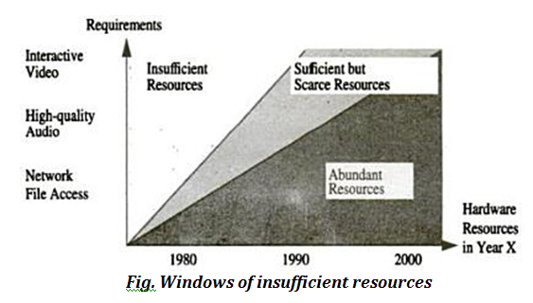

Slide 10
8.1.3Resource requirement allocation scheme
Requirements:
The transmission and processing requirements of local and distributed multimedia applications can be specified according to the following characteristics :
Throughput: Determined by the needed data rate of a connection to satisfy the application requirements.
Delay "at the resource" (local): The maximum time span for the completion of a certain task at this resource.
End-to-end delay (global): The total delay for a data unit to be transmitted from the source to its destination.
Jitter: Determines the maximum allowed variance in the arrival of data at the destination.
Reliability: Defines error detection and error correction mechanisms used for the transmission and processing of multimedia tasks.
How to handle errors: Ignored, indicated and/or corrected.
Retransmission may not be acceptable for time critical data.
These requirements are known as Quality of Service (QoS) parameters.

Slide 11
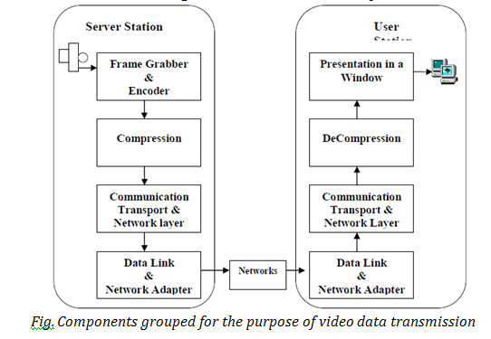

Slide 12
Phases of the resource reservation and management process
Schedulability
The resource manager checks with the given QoS parameters (e.g. throughput and reliability).
QoS calculation
The resource manager calculates the best possible performance (e.g. delay) the resource can guarantee for the new request.
Resource reservation
Allocates the required capacity to meet the QoS guarantees for each request.
Resource scheduling
Incoming messages (i.e. LDUs) from connections are scheduled according to the given QoS guarantees.
LDU= logical data unit
QoS= Quality of service

Slide 13
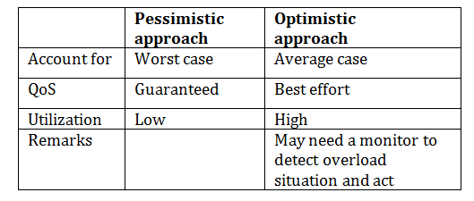
Allocation Scheme
Reservation of resources can be made either in a pessimistic or optimistic way:
The pessimistic approach avoids resource conflicts by making reservations for the worst case. (It's very conservative.)
The optimistic approach reserves resources according to an average workload only.

Slide 14
8.1.4 Continuous media resource model
It is based on the model of linear bounded arrival process (LBAP).
A distributed system is decomposed into a chain of resources traversed by the messages on their end-to-end path.
The data stream consists of LDUs (messages).
Various data streams are independent of each other.
The model considers a burst of messages consists of messages that arrived ahead of schedule.
LBAP is a message arrival process at a resource defined by 3 parameters:
M = maximum message size (byte/message)
R = maximum message rate (message/second)
B = maximum burstiness (message)

Slide 15

Burst:
Bursts are generated
When data is transferred from disk in a bulk transfer mode
When messages are assembled into larger packets
When traffic congestion is experienced
In the model, it is assumed that, during a time interval of length t, the maximum number of messages arriving at a resource must not exceed .
Maximum buffer size
Messages arriving ahead must be queued in a buffer.
The buffer size is S = M ×(B +1) (bytes)
Logical backlog
Logical backlog is the number of messages which have already arrived "ahead of schedule" at the arrival of message m.

Slide 16
8.1.5 Process Management
Process:
Program in execution.
It contains program code and current activity.
It deals with administration of the resource main processor.
Process management is key function of operating system.
The capacity of this resource is specified as processor capacity.
The process manager maps single processes onto resources according to a specified scheduling policy such that all processes meet their requirements.
A process under control of the process manager can be in one of the 4 states:
Idle state:
No process is assigned to the program.
Blocked state:
The process is waiting for an event, i.e., it lacks one of the necessary resources for processing.
Ready-to-run state:
All necessary resources except the processor are assigned to the process.
Running state:
A process is running as long as the system processor is assigned to it.

Slide 17
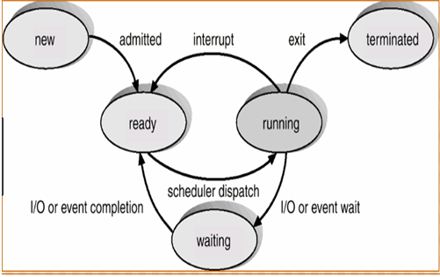
The process manager is the scheduler.
The scheduler transfers a process into the ready-to-run state by assigning it a position in the respective queue of the dispatcher.
Dispatcher is the essential part of the operating system kernel.
The next process to run is chosen according to a priority policy.
The process with the longest ready time is chosen if more than one process have equal priority.

Slide 18
8.1.6 Real-time Processing requirement
The real-time process manager determines a schedule for the resource CPU that allows it to make reservations and to give processing guarantees.
The problem is to find a feasible scheduler which schedules all time critical continuous media tasks
Each of them can meet its deadlines.
In a multimedia system, continuous and discrete media data are processed concurrently.
There are 2 conflicting goals for scheduling of multimedia tasks.
An uncritical process should not suffer from starvation because time-critical processes are executed. (e.g. should handle text while handling video.)
A time-critical process must never be subject to priority inversion.
One should minimize:
The overhead caused by the schedulability test and the connection establishment
The costs for the scheduling of every message.

Slide 19
Real-time system determines:
Order of real time task execution
Static-priority scheduling
Dynamic-priority scheduling
Static scheduling:
Scheduling decision based on fixed parameters
Schedules are assigned before their activation
Example: highest priority scheduling
Dynamic scheduling:
Scheduling decision based on dynamic parameters
Parameters may change during system evolution
Example: Earliest deadline first scheduling

Slide 20
8.1.7 Real-time Scheduling
Traditional real-time scheduling
Goal( on time-sharing computers): optimal throughput, optimal resource utilization and fair queuing.
Goal of real-time tasks: to provide a schedule that allows all, respectively, as many time-critical processes as possible, to be processed in time, according to their deadline.
Schedulability is the property indicating whether a RTS can meet their deadlines or not.
Two basic algorithms for solving real-time scheduling problems:
Earliest deadline first algorithm (EDF)
Rate monotonic scheduling (RM)

Slide 21
8.1.8 Earliest Deadline First Algorithm
The highest priority is assigned to the task with the earliest deadline i.e a task with a shorter deadline executes first.
Deadline is required.
EDF is an optimal, dynamic algorithm(optimal dynamic priority scheduling).
At every new ready state, the scheduler selects the task with the earliest deadline among the tasks that are ready and not fully processed.
At any arrival of a new task, EDF must be computed immediately leading to a new order and the new task is scheduled according to its deadline.
The running task is preempted.
No guarantee about the processing of any task can be given.
It has a lot of overhead.
Extension of EDF : Time-Driven Scheduler (TDS)

Slide 22
8.1.9 Rate Monotonic Algorithm
It is an optimal, static, priority-driven algorithm for preemptive, periodic jobs.
Task with higher rate has higher priority.
It assigns priority according to period i.e a job with a shorter period has a higher priority. Period= total execution time
Deadline is not required.
It is optimal in a way that it can provide the same schedule any static algorithm can provide.
There are 5 necessary prerequisites to apply the rate monotonic algorithm:
The requests for all tasks with deadlines are periodic.
Each task must be completed before the next request occurs.
All tasks are independent.
Run-time for each request of a task is constant
Any non-periodic task in the system has no required deadline.
A process is scheduled by a static algorithm at the beginning of the processing.
Each task is processed with the priority calculated at the beginning.
No further scheduling is required.

Slide 23
Example: EDF and RM
Process | Period( Execution time) (Second) | Deadlines (a.m)
P1 | 15 | 10
P2 | 20 | 9:45
P3 | 9 | 11
Priorities:
EDF: P2,P1,P3
RM: P3,P1,P2

Slide 24
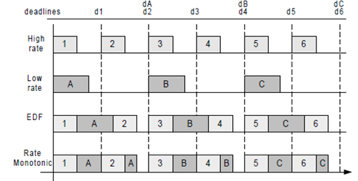
EDF and Rate Monotonic: Context switches
Fig. Rate monotonic vs. EDF: context switches in preemptive systems

Slide 25
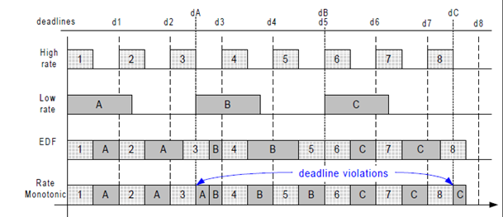
EDF and Rate Monotonic: Processor Utilization
Fig. Rate monotonic vs. EDF: processor utilization

Slide 26
Extensions to Rate Monotonic Scheduling
Divides a task into a mandatory and an optional part.
The processing of the mandatory part delivers a result which can be accepted by the user.
The optional part only refines the result.
Preemptive versus Non-preemptive task scheduling
A non-preemptive task is processed and not interrupted until it is finished or requires further resources.
A preemptive task is processed and can be interrupted without completion of task in between execution process.
Assignment: EDF Vs RM

Slide 27
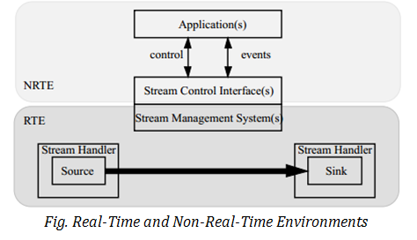
8.1.10 System Architecture
The most dominant characteristic of multimedia applications is the real-time requirement. This should be handled in a real-time environment (RTE).
To coexist with conventional OS, NRTE and RTE have to be integrated so that RTE can be accessed from NRTE.

Slide 28
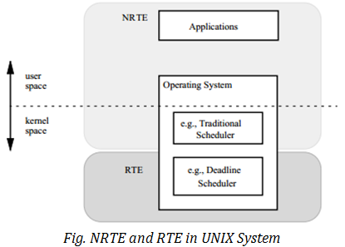
UNIX-based Systems

Slide 29
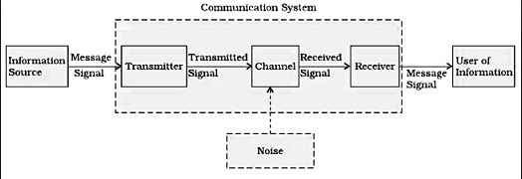
8.2 Multimedia Communication System
A communications system is a collection of communications equipment that is integrated into a coherent system. These allow different people to stay in touch over a geographical system.
Fig: Block Diagram of Communication System
Multimedia communication system is the communication system which deals with multimedia data.

Slide 30
Multimedia Communication System
The important issues related to multimedia communication systems which are present above the date link layer.
The consideration of multimedia applications supports the view that local systems expand toward distributed solutions.
From the communication perspective, we divide the higher layers of the Multimedia Communication System (MCS) into two architectural subsystems:
application subsystem
transport subsystem

Slide 31
8.2.1 Multimedia Communication Architecture
Group Communication(GC) Architecture:
GC involves the communication of multiple users in a synchronous or an asynchronous mode with centralized or distributed control.
A group communication architecture consists of a support model, system model and interface model.
The GC support model includes group communication agents that communicate via a multi-point multicast communication network as shown in following Figure.

Slide 32
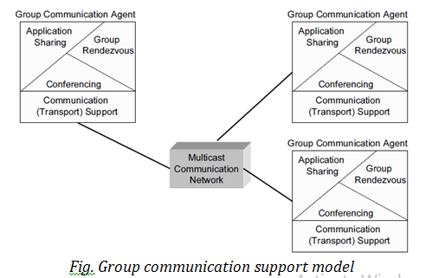

Slide 33
Group communication agents may use the following for their collaboration:
Group Rendezvous
Group rendezvous denotes a method which allows one to organize meetings, and to get information about the group, ongoing meetings and other static and dynamic information.
Shared Applications
Application sharing denotes techniques which allow one to replicate information to multiple users simultaneously.
Conferencing applications belong to collaboration-aware applications.
The remote users may point to interesting aspects (e.g., via tele-pointing) of the information and modify it so that all users can immediately see the updated information (e.g., joint editing).
Shared applications mostly belong to collaboration transparent applications.
Conferencing
Conferencing is a simple form of collaborative computing.
This service provides the management of multiple users for communicating with each other using multiple media.

Slide 34
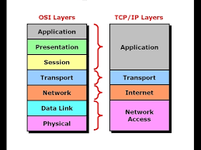
OSI Model
Open Systems Interconnection model (OSI model) is a conceptual model that characterizes and standardizes the communication functions of a telecommunication or computing system without regard to its underlying internal structure and technology.

Slide 35
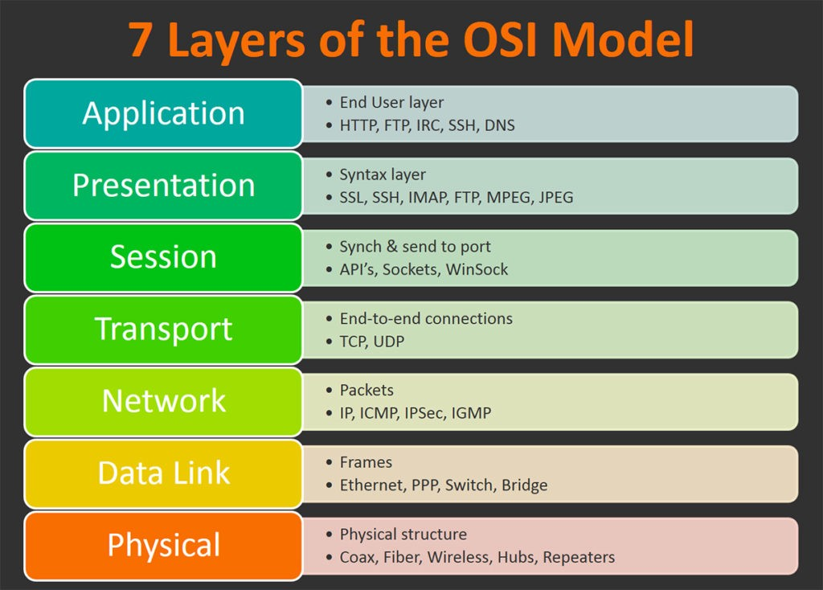

Slide 36
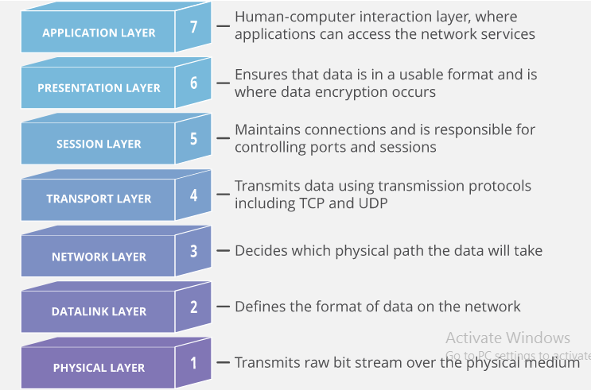

Slide 37
8.2.2 Application Subsystem
It includes:
Collaborative Computing
Session Management
1. Collaborative Computing
The current infrastructure of networked workstations and PCs, and the availability of audio and video at these end-points, makes it easier for people to cooperate and bridge space and time.
In this way, network connectivity and end-point integration of multimedia provides users with a collaborative computing environment.
Collaborative computing is generally known as Computer-Supported Cooperative Work (CSCW).
Tools for cooperative Computing
Electronics mail
Bulletin boards
Screen sharing tools
Application sharing
Text-based conferencing system
Video conference systems(e.g MBone Tools, ProShare from Intel, PictureTel, Teles Online, NetMeeting from Microsoft)

Slide 38
Cooperative Computing Cooperation Dimension
Computer-Supported cooperation may be categorized according to the following parameters:
Time:
Asynchronous cooperative work(not at the same time)
Synchronous cooperative work (at the same time)
User Scale:
Single users, two users(“dialogue, point to point”, direct cooperation or groups with more than two users
Static or dynamic groups, if either the members are pre-determined or not
Control:
Centralized, i.e. controlled by a “chairman”
Distributed i.e. control protocols provide consistent cooperation
Locality:
Cooperation at the same place
Tele-cooperation of users at different places
Session management:

Slide 39
2. Session management
It is an important part of the multimedia communication architecture.
It is the core part which separates the control, needed during the transport, from the actual transport.
Session is server side storage that is desired to persist throughout the user’s interaction with website or web application.
It includes 2 steps to process session state:
Establishment of session
Modification of session

Slide 40
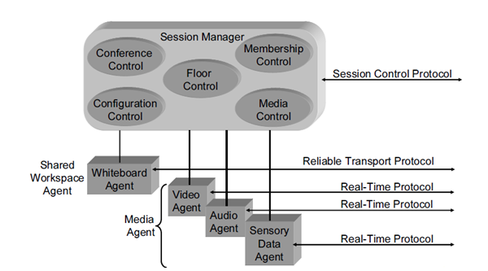
Session management architecture
By creating a reusable session manager, which is separated from the user-interface, conference-oriented tools avoid a duplication of their effort.

Slide 41
The session control architecture consists of the following components:
Session Manager
Session manager includes local and remote functionalities. Local functionalities may include
Membership control management, such as participant authentication or presentation of coordinated user interfaces;
Control management for shared workspace, such as floor control
Media control management, such as intercommunication among media agents or synchronization
Configuration management, such as an exchange of interrelated QoS parameters of selection of appropriate services according to QoS; and
Conference control management, such as an establishment, modification and a closing of a conference.
Media agents
Media agents are separate from the session manager and they are not responsible for decisions specific to each type of media.
The modularity allows replacement of agents.
Each agent performs its own control mechanism over the particular medium, such as mute, unmute, change video quality, start sending, stop sending, etc.
Shared Workspace Agent
The shared workspace agent transmits shared objects (e.g., telepointer coordinate, graphical or textual object) among the shared application.

Slide 42
Floor Control:
Within shared workspaces, it is employed to provide access to the shared workspace.
It maintains data consistency.
Conference Control:
It is employed to conference control .
It controls overall conference activities.
Configuration Control:
It includes a control of media quality, QOS handling, resource availability and other system components to provide session according to the users requirements.
Membership Control:
It may includes services such as invitation to the session registration, modification of session, etc.
Media Control:
It mainly includes a functionality such as synchronization of media stream, etc.

Slide 43
8.2.3 Transport Subsystem
In order to distribute a multimedia product, it is necessary to have a set of protocols which enable smooth transmission of data between two hosts.
The protocols are the rules and conventions useful for network communication between two computers.
Requirements
Distributed multimedia applications put new requirements on application designers, As well as network protocol and system designers.
User and Application Requirements on Transport Subsystems
Data Throughput – need to support application data with stream-like behavior and in real time
Fast data forwarding – the faster the transport system can move packets the fewer packets have to be buffered
Service Guarantees – need appropriate resource management
Multicasting – need service for efficient resource sharing and reaching groups of users in applications such as video conferencing

Slide 44
Protocols used in Transport layer
TCP (Transmission Control Protocol)
UDP (User Datagram Protocol)
RTP (Real-time Transport Protocol)
XTP (Xpress Transport Protocol)
Tenet Transport Protocols, etc.
Assignment: TCP vs UDP

Slide 45
Network Layer
The requirements on the network layer for multimedia transmission are:
high bandwidth
Multicasting
resource reservation
Qos guarantees
new routing protocols
(with support for streaming capabilities and new higher-capacity routers with support of integrated services.)
Protocols :
Internet Protocol (IP)
Internet Group Management Protocol (IGMP)
Resource reservation Protocol (RSVP), etc.

Slide 46
8.2.4 Quality of Service and resource management
Main goal of Resource Management
Providing guaranteed delivery of multimedia data
Three main actions:
Resource and allocate resource(end-to-end) during establishment
Provide resource according to QoS specification
Adapt to resource changes during data processing

Slide 47
Quality of Service and Resource Management
The user/application requirements on the Multimedia Communication System (MCS) are mapped into communication services which make the effort to satisfy the requirements.
Because of the heterogeneity of the requirements, coming from different distributed multimedia applications, the services in the multimedia systems need to be parameterized.
Parameterization allows for flexibility and customization of the services, so that each application does not result in implementing of a new set of service providers.

Slide 48
Quality of Service(QoS)
It refers to any technology that manages data traffic to reduce packet loss, latency and jitter on the network.
QoS controls and manages network resources by setting priorities for specific types of data on the network.
QoS parameters:
Packet loss (Reliability) : happens when network links become congested and routers and switches start dropping packets.
Jitter: is the result of network congestion, timing drift and route changes. Too much jitter can degrade the quality of voice and video communication.
Latency: is the time it takes a packet to travel from its source to its destination.
Bandwidth: is the capacity of a network communications link to transmit the maximum amount of data from one point to another in a given amount of time. QoS optimizes the network by managing bandwidth and setting priorities for applications that require more resources than others.
End-to-end Delay: the total delay experienced by frames from traveling from the sender to the receiver.

Slide 49
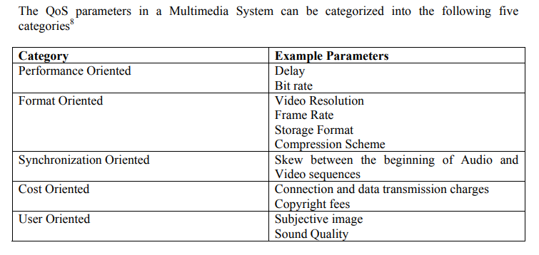

Slide 50
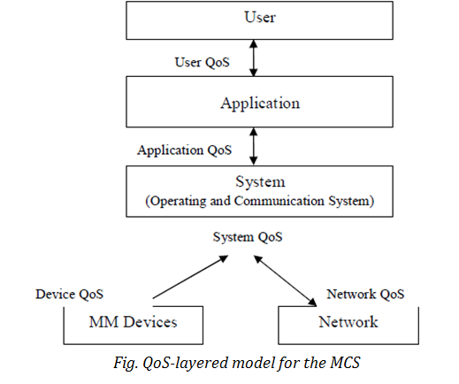
QoS Layering

Slide 51
Traditional QoS (ISO standards) was provided by the network layer of the communication system.
An enhancement of QoS was achieved through inducing QoS into transport services.
For MCS, the QoS notion must be extended because many other services contribute to the end-to-end service quality.
The MCS consists of three layers:
application,
system(including communication services and operating system services)
devices (network and Multimedia (MM) devices)
QoS-layered model for the multimedia communication system include 4 layers.
user QoS layer
application Qos-layer
system Qos layer
network Qos layer

Slide 52
Managing Resources during Multimedia Transmission
QoS guarantees must be met in the application, system and network to get the acceptance of the users of MCS.
There are several constraints which must be satisfied to provide guarantees during multimedia transmission:
time constraints which include delays;
space constraints such as system buffers;
device constraints such as frame grabbers allocation;
frequency constraints which include network bandwidth and system bandwidth for data transmission; and,
reliability constraints.
These constraints can be specified if proper resource management is available at the end-points, as well as in the network.

Slide 53
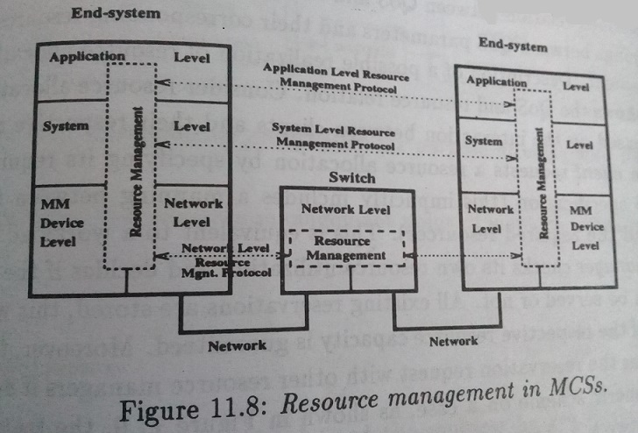
Resource Management Architecture

Slide 54
Assignment:
Multimedia protocols
Transport layer
Network layer
Application layer
TCP Vs UDP

Slide 55
8.3 Abstraction of Programming
Most of the current commercial available multimedia applications are implemented in procedure-oriented programming languages (structural languages) such as C.
In the part, multimedia specific functions (Example, changing the volume while playing an audio passage) were called, are respectively controlled, through hardware-specific libraries or device drivers.
The application code of most commercial multimedia application programs are still highly dependent a hardware.
Some applications are implemented with the help of tools.

Slide 56
8.3.1 Abstraction level:
Abstraction levels in programming define different approaches with a varying degree of detail for representing, accessing and manipulating data.
The abstraction levels with respect to multimedia data and their relations among each other is shown in the figure below.
A multimedia application may access each level.

Slide 57
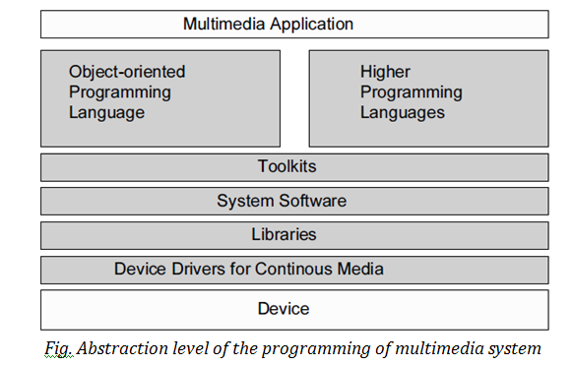

Slide 58
Device:
A device for processing continuous media can exist as a separate component in a computer. In this case, a device is not part of the operating system, but is directly accessible to every component and application.
A library, the simplest abstraction level, includes the necessary functions for controlling the corresponding hardware with specific device access operations.
Device Drivers:
As with any device, multimedia device can be bound through a device driver, respectively with operating system.
Hence, the processing of the continuous data becomes part of the system software.

Slide 59
Libraries system software
Libraries:
The Processing of continuous media is based on a set of functions which are embedded into libraries.
Library is the built-in storage, which contains data related to the system. Goal: To make user’s task easy and efficient.
This is the usual solution for programming multimedia data.
These libraries are provided together with the corresponding hardware.
The devices driver and /or library, which control all available function also support each devices. Here, the libraries differ very much in their degree of abstraction.
Some libraries can be considered as extensions of the graphical user interface, whereas other libraries consist of control instructions passed as control blocks to corresponding devices.
Libraries are very useful at the operating system level, but there is no agreement (and may never) over which function are for different drivers, i.e which functions should be support.

Slide 60
System Software
It is a type of computer program that is designed to run a computer’s hardware and application programs.
Example: Operating system
Device access becomes part of the operating system:
Data as Time Capsules (file extensions)
each Logical Data Unit (LDU) carries in its time capsule its data type, actual value and valid life span
useful concept for video, where each frame has a valid life span of 40ms (rate of read access during a normal presentation)
presentation rate is changed for VCR (Video Casette Recorder) functions like fast forward, slow forward or fast rewind by
changing the presentation life span of a LDU
skipping of LDUs or repetition of LDUs
2. Data as Streams
a stream denotes the continuous flow of audio and video data between a source and a sink
prior to the flow the stream is established equivalent to the setup of a connection in a networked environment

Slide 61
Toolkits:
These are collection of tools and techniques, which are used to modify multimedia data.
Example:
Simpler approach than the system software interfaces from the user’s point of view are Toolkits
allow a uniform interface for communication with all different devices of continuous media
introduce the client-server paradigm
can hide the process-structures
can be embedded into programming languages or object-oriented environments
Tool-kits should represent interfaces at the system software level. In this case it is possible to embed them into the programming languages or object oriented environment.

Slide 62
Example of Toolkits
Presentation Software
Microsoft PowerPoint
Adobe Presenter
Image Editing
Adobe Photoshop
Audio Recording/Editing
- Audacity
It is a free and open-source digital audio editor and recording application software, available for Windows, macOS/OS X and Unix-like operating systems

Slide 63
Higher level Programming Language (HLL)
It is programming language, where we can use human understandable words (example: English ) to write code.
It enables a programmer to write programs that are more or less independent of a particular type of computer. Such languages are considered high-level because they are closer to human languages and further from machine languages. Example: C, C++, Pascal, C#, etc.
In such an HLL, the processing of continuous media data is influenced by a group of similar constructed functions.
These calls are mostly hardware and driver independent. Hence, their integration in HLLs lends to a wishful abstraction supports a better programming style and increases the productivity.
Programs must be capable of supporting and effectively manipulating multimedia data.
Therefore, the programs in HLL either direct access multimedia data structure or communicate directly with the active process in a real-time environment
Media as Types:
definition of appropriate data types (e.g. for video and audio)
smallest unit can be a LDU
example of merging a text and a motion picture (OCCAM-2)

Slide 64
Object-oriented approach
It is a programming language model in which programs are organized around data, or objects, rather than functions and logic.
An object can be defined as a data field that has unique attributes and behavior.
Basic ideas of object-oriented programming are data encapsulation inheritance, in connection with class and object definitions.
Class (implementation of a abstract data type)
Object (instance of a class)
Other important properties of object-oriented systems are:
Inheritance
Polymorphism
Encapsulation
Abstraction( Hiding), etc.
Example:
C++, JAVA, Python, VB. Net, etc

Slide 65
Devices as Classes:
devices are assigned to objects which represent their behaviour and interface
Processing Units as Classes
Three main objects:
source objects
destination objects
combined source-destination objects
(It allows the creation of data flow paths through connection of objects.)
Further, the reuse of software component is a main advantage of this approach.
The basic ideas behind object-oriented programming are: data encapsulation and inheritance, in connection with class and object definitions.

Slide 66
8.4 Abstraction of Programming Synchronization
8.4.1 Introduction
The word synchronization refers to time.
It refers to the co-ordination of events to operate in unison.
Synchronization in multimedia systems refers to the temporal relations between media objects in the multimedia system. (Definition)
Synchronization in multimedia systems as comprising content, spatial and temporal relations between media objects.
We differentiate between time-dependent media object are equal, it is called continuous media object.
A video consists of a number of ordered frames; each of these frames has fixed presentation duration.
A time-independent media object is any kind of traditional media like text and images.
The semantic of the respective content does not depend upon a presentation according to the time domain.
Synchronization between media objects comprises relations between time dependent media objects and time-independent media objects.
A daily example of synchronization between continuous media is the synchronization between the visual and acoustical information in television.

Slide 67
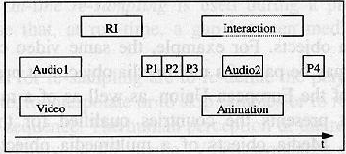
Fig: Example of synchronization

Slide 68
8.4.2 Notion of Synchronization
Notion refers to the concept or belief.
A) Multimedia System:
Three criteria for the classification of a system as a multimedia system can be distinguished: the number of media, the types of supported media and the degree of media integration.
The simplest criterion is the number of media used in an application, using only this criterion, even a document processing application that supports text and graphics can be regarded as a multimedia system.
The arrows indicate the increasing degree of multimedia capability for each criterion.
Integrated digital systems can support all types of media, and due to digital processing, may provide a high degree of media integration.
Systems that handle time dependent analog media objects and time-independent digital media objects are called hybrid systems.

Slide 69
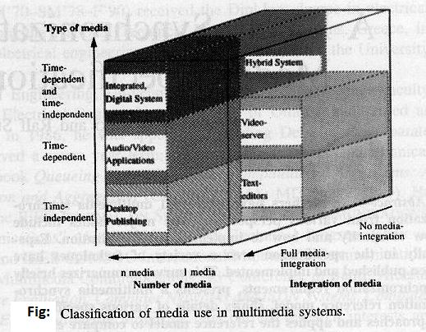
The following figure classifies applications according to the three criteria.
The arrows indicate the increasing degree of multimedia capability for each criterion.

Slide 70
B) Basic Synchronization Issues
Integrated media processing is an important characteristic of a multimedia system.
The main reasons for these integration demands are the inherent dependencies between the information coded in the media objects.
These dependencies must be reflected in the integrated processing including storage, manipulation, communication, capturing and, in particular, the presentation of the media objects.
Content Relations
Content relations define a dependency of media objects from data.
Spatial Relations
The spatial relations that are usually known as layout relationships define the space used for the presentation of a media object on an output device at a certain point of time in a multimedia presentation.
If the output device is two-dimensional (e.g., monitor or paper), the layout specifies the two-dimensional area to be used.
In desktop-publishing applications, this is usually expressed using layout frames.
A layout frame is placed and content is assigned to this frame.
The positioning of a layout frame in a document may be fixed to a position in a document, to a position on a page or it may be relative to the positioning of other frames.

Slide 71
Temporal Relations
Temporal relations define the temporal dependencies between media objects.
They are of interest whenever time-dependent media objects exist.
Example: the relation between a video and an audio object that are recorded during a concert. If these objects are presented, the temporal relation during the presentations of the two media objects must correspond to the temporal relation at the recording moment.

Slide 72
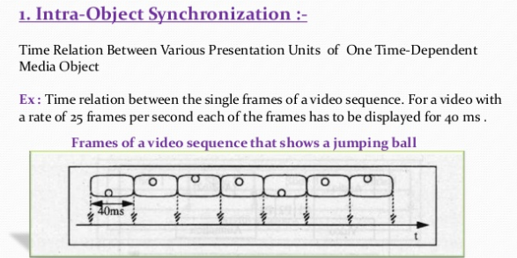
C) Intra and Inter Object Synchronization

Slide 73
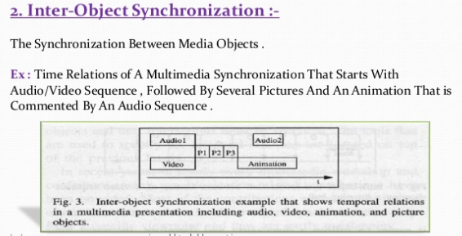

Slide 74
D) Live and Synthetic Synchronization
The live and synthetic synchronization distinction refers to the type of the determination of temporal relations.
In the case of live synchronization, the goal of the synchronization is to exactly reproduce at a presentation the temporal relations as they existed during the capturing process.
In the case of synthetic synchronization, the temporal relations are artificially specified.
I) Live Synchronization
A typical application of live synchronization is conversational services.
In the scope of a source/sink scenario, at the source, volatile data streams (i.e., data being captured from the environment) are created which are presented at the sink.

Slide 75
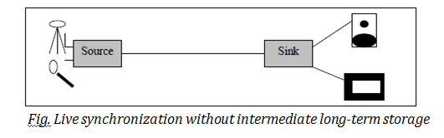
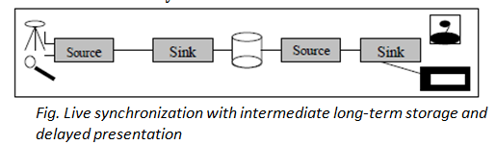

Slide 76
II) Synthetic Synchronization
The emphasis of synthetic synchronization is to support flexible synchronization relations between media.
In synthetic synchronization, two phases can be distinguished:
In the specification phase, temporal relations between the media objects are defined.
In the presentation phase, a run-time system presents data in a synchronized mode.

Slide 77
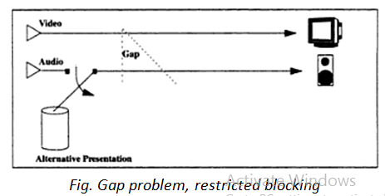
8.4.3 Presentation requirement
Presentation requirements comprise, for intra-object synchronization, the accuracy concerning delays in the presentation of LDUs and, for inter-object synchronization, the accuracy in the parallel presentation of media objects.
For intra-object synchronization, we try to avoid any jitter in consecutive LDUs.
Whereas processes can wait for each other, using the method of blocking, a data stream of time independent LDUs can also be stopped.

Slide 78
Lip synchronization Requirements
Lip synchronization refers to the temporal relationship between an audio and video stream for the particular case of human speaking.
The time difference between related audio and video LDUs is known as the skew. Streams which are perfectly “in sync” have no skew, i.e., 0 ms.
Pointer synchronization Requirements
In a computer-Supported Co-operative Work (CSCW) environment, cameras and microphones are usually attached to the users’ workstations.
All participants had a window with these graphics on their desktop where a shared pointer was used in the discussion.
Using this pointer, speakers pointed out individual elements of the graphics which may have been relevant to the discussion taking place.
This obviously required synchronization of the audio and remote tele- pointer.
Telepointer is a powerful tool in the telemedicine system that enhances the effectiveness of long-distance communication.

Slide 79
8.4.4 Reference model for multimedia synchronization
A four-layer synchronization reference model is shown in the following Figure.
Each layer implements synchronization mechanisms which are provided by an appropriate interface.
These interfaces can be used to specify and/or enforce the temporal relationships.
Each interface defines services, i.e., offering the user a means to define his/her requirements.
Each interface can be used by an application directly, or by the next higher layer to implement an interface.
Higher layers offer higher programming and Quality of Service (QoS) abstractions.
For each layer, typical objects and operations on these objects are described in the following.
The semantics of the objects and operations are the main criteria for assigning them to one of the layers.

Slide 80
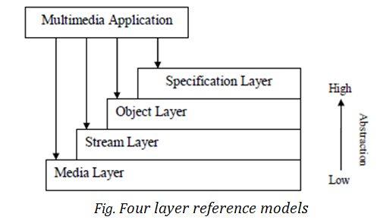
Media Layer
Application handles only one continuous media stream as an LDU sequence
Device-independent interface, file and device access
Read (device-handle, LDU)
Write (device-handle, LDU)
Application runs one process for each stream
Guarantees single LDU processing

Slide 81
Stream Layer
Handles continuous media streams and media stream groups
Guarantees intra-stream synch
Group presents streams in parallel
Gurarantees inter-stream synch of streams in a group
Handles resource reservation and scheduling of LDU processing
Typical operations
start (stream), stop (stream)
create_group (list_of_streams)
start (group), stop (group)
setcuepoint (stream/group, at, event)
Object Layer
Deals with all kinds of media
Hides the difference between discrete and continuous media
Accepts a synchronization specification as input
Media-oriented QoS (such as allowed skew, allowed jitter)
Plans and coordinates presentation execution
Initiates presentation of time-dependent and time-independent media objects

Slide 82
Specification Layer
Does not provide a specific interface, is open
Tools for generating synch specification
Edit
Format
Maps user interface QoS specifications to the Object Layer

Slide 83
8.4.5 Synchronization specification
The synchronization specification of a multimedia object describes all temporal dependencies of the included objects in the multimedia object.
It is produced using tools at the specification layers and is used at the interface to the object layer. Because the synchronization specification determines the whole presentation, it is a central issue in multimedia systems.
In the following, requirements for synchronization specifications are described and specification methods are described and evaluated.
A synchronization specification should be comprised of:
Intra-object synchronization specifications for the media objects of the presentation.
QoS descriptions for intra-object synchronization.
Inter-object synchronization specifications for media objects of the presentation.
QoS descriptions for inter-object synchronization.
The synchronization specification is part of the description of a multimedia object.

